Slide 1
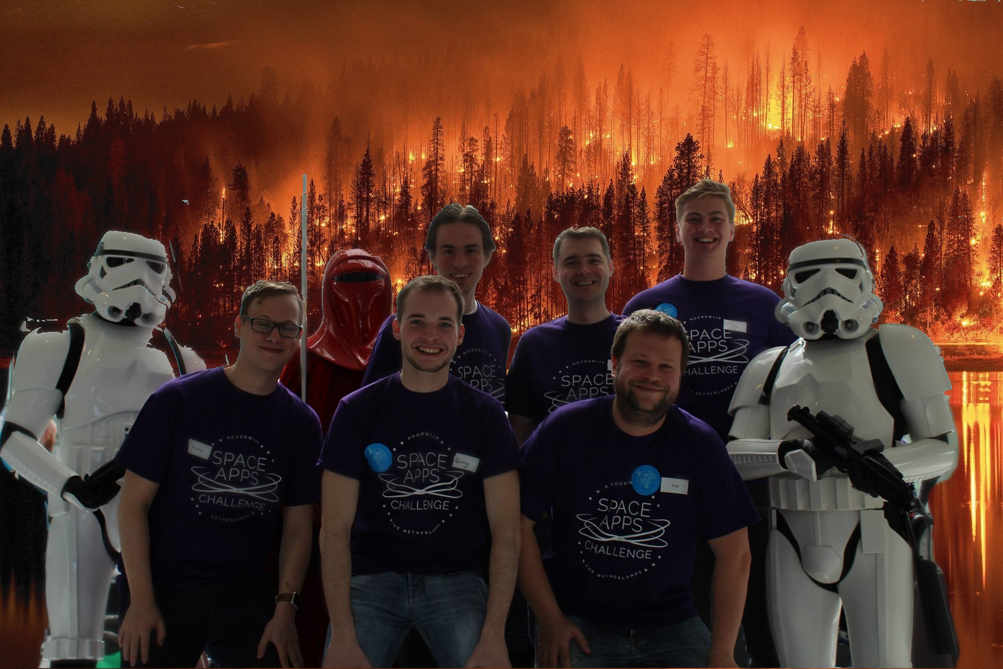


Slide 2
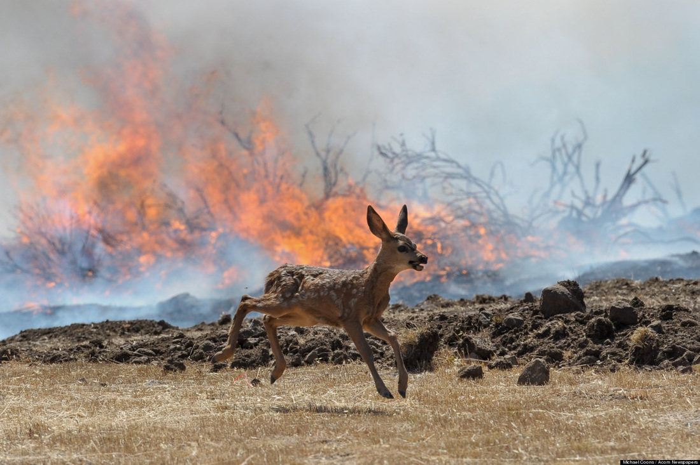

Slide 3

Prevention
Detection
Control

Slide 4
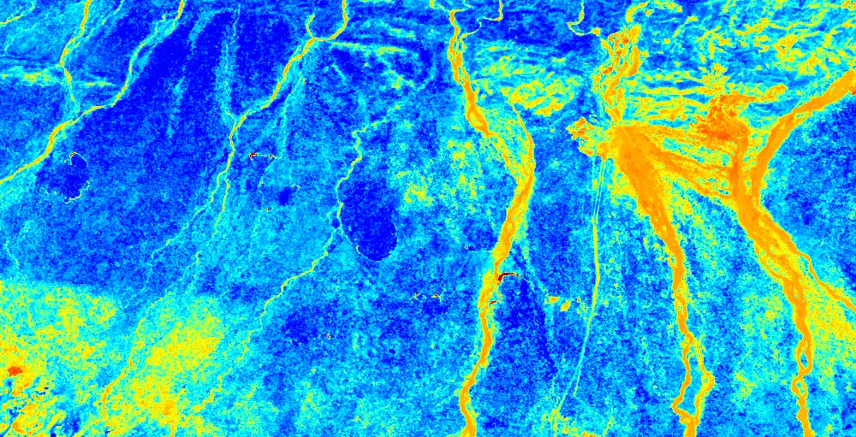
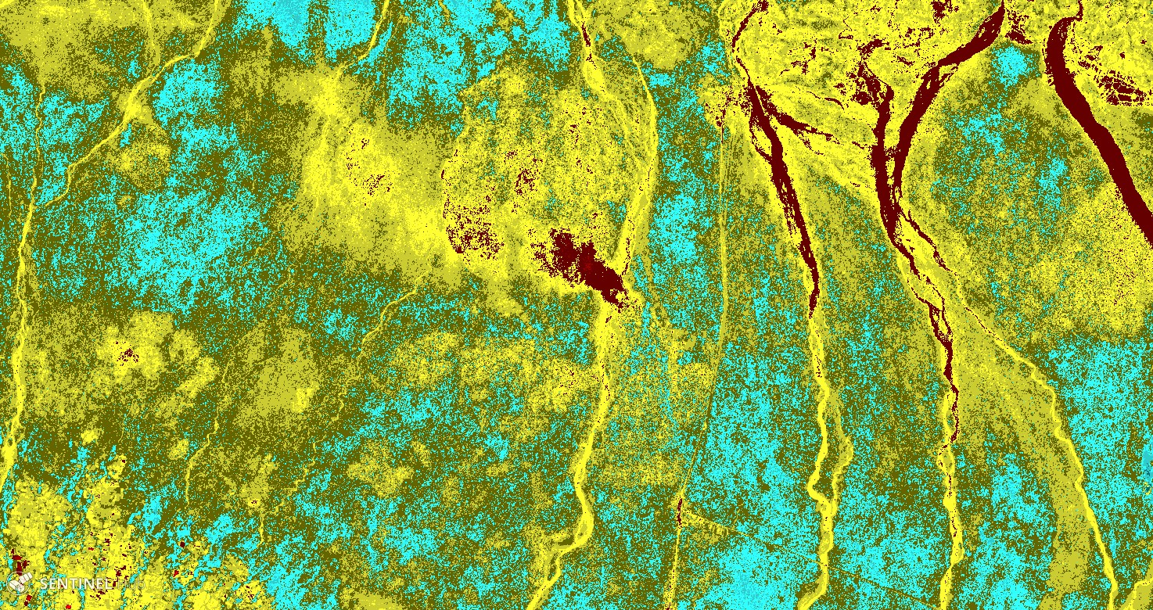
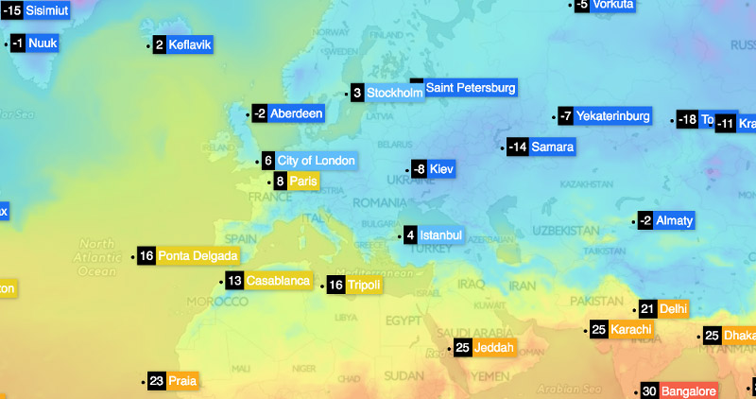
Prevention
Sentinel 2 Moisture data
Sentinel 2 Vegetation data
Weather Data
Result: Heatmap showing potential wildfire hotspots.
Potential customers: National Parks, Nature Reserves, Local Governments

Slide 5
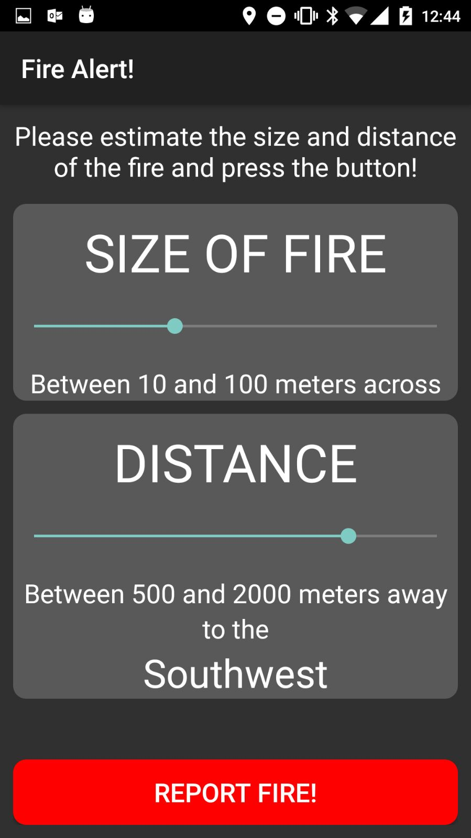
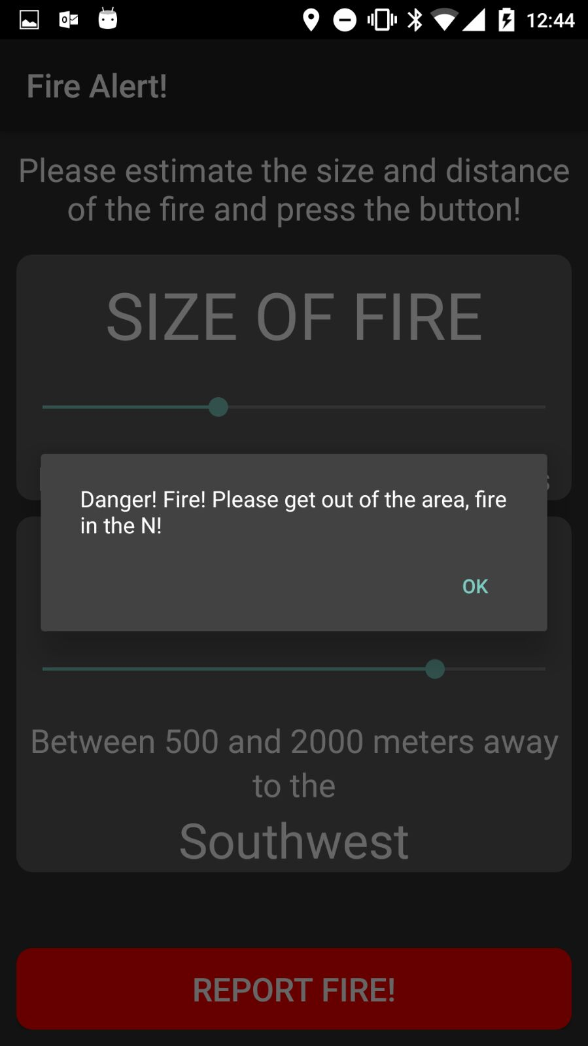
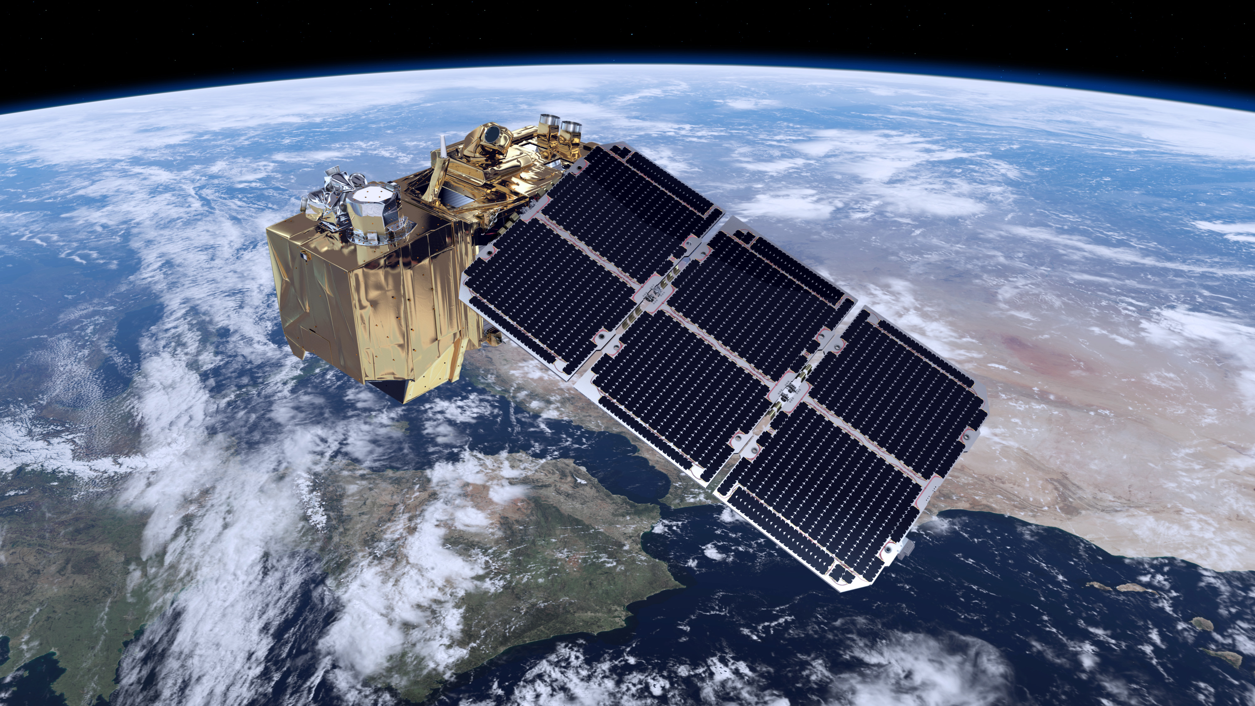


Detection
VIIRS data
Sentinel 2 Data
Social Data
Result: Early wildfire detection
Potential customers: National Parks, Nature Reserves, Local Governments

Slide 6
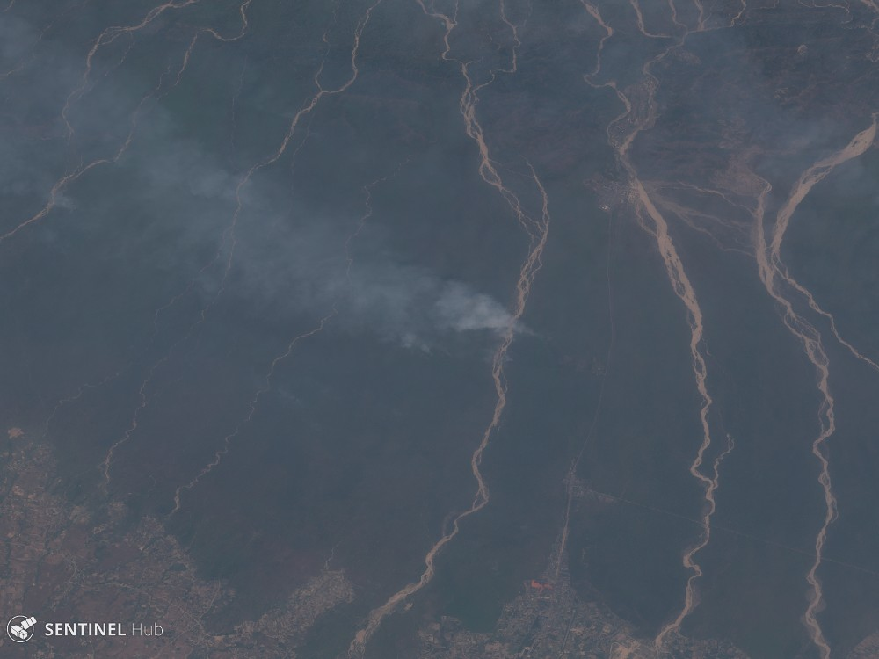
Detection

Slide 7
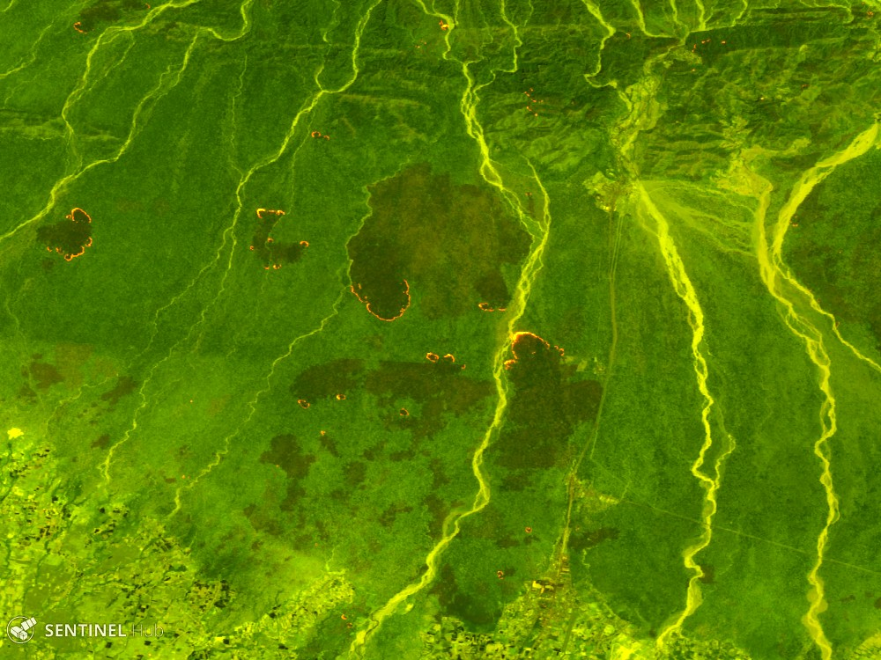
Detection

Slide 8
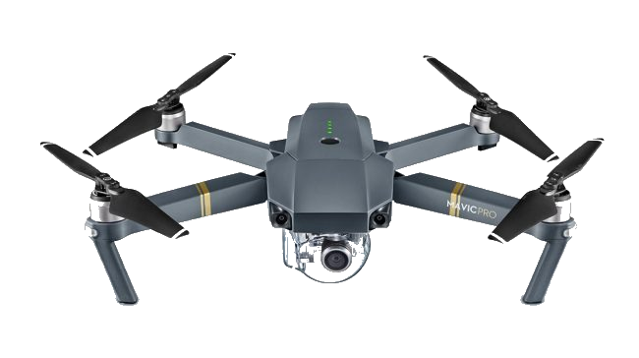
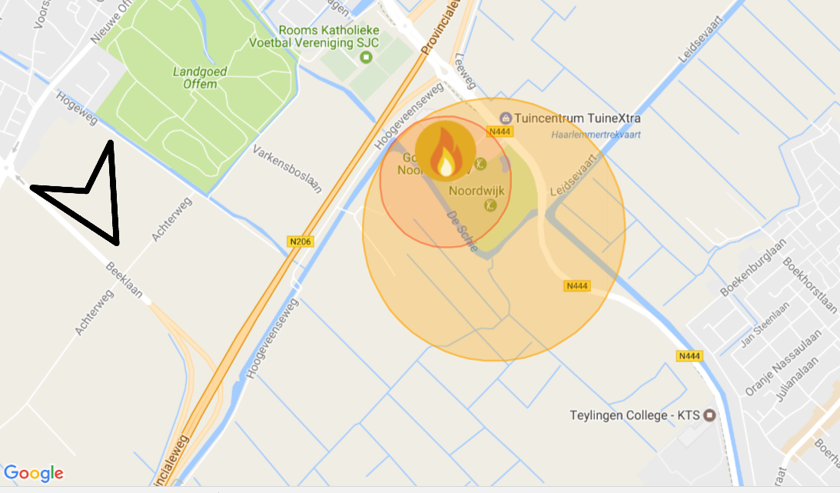
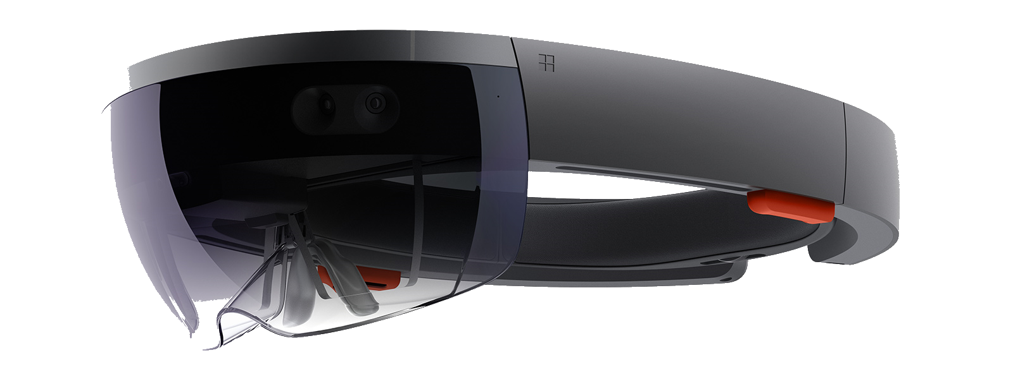
Control
Real-time aerial (heat/IR) data
Real-time Fire Prediction
Fire Fighter Heads Up Display
Result: Optimal Fire Control
Potential customers: Fire Brigades

Slide 9
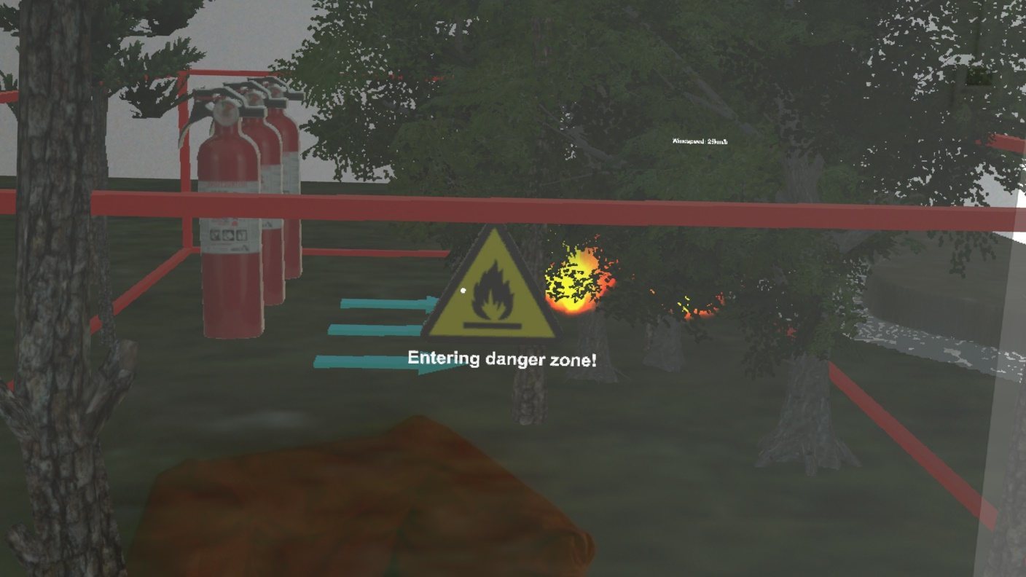
Control

Slide 10
And YOU can Help Fight Fires!
Thank You
#nasafires

